Slide 1

Getting a Research Computing Account

Slide 2
Getting a Research Computing Account
Instructor: Trevor Hall
Workshop: Quick Byte
Website: www.rc.colorado.edu
Helpdesk: rc-help@colorado.edu
Slides: https://github.com/ResearchComputing/New_User_Seminar
Survey: http://tinyurl.com/curc-survey18

Slide 3

RMACC Cyber Infrastructure Portal
https://ask.cyberinfrastructure.org/c/rmacc/65
This forum provides opportunity for RMACC members to converse amongst themselves and with the larger, global research computing community.
The “go to” general Q&A platform for the global research computing community - researchers, facilitators, research software engineers, CI engineers, sys admins and others.
Notes:
Stack exchange but for RC specifically

Slide 4
Learning Goals
Understand Basic CURC Resources & the Alpine cluster
Getting an account & logging in

Slide 5


Resources Include:
High Performance Computing (HPC)
Storage of Research Data
High-Speed Data Transfer
Data Sharing
Cloud Computing
Training and Education
Secure Research
Notes:
Can advise on Secure Research, have a CMMC environment (Preserve) available (let know available if doing DoD or DoE things)

Slide 6

Primarily known for:
High Performance Computing (HPC)

Slide 7
What can I use HPC for?
Solving large problems that require more:
Memory than you have on your PC
cores/nodes/power thank you have on your PC
Jobs that require hardware you may not have:
High Performance GPU computing
Specific Operating System
Visualization rendering

Slide 8
HPC Cluster: Alpine
Alpine is the 3rd-generation HPC cluster at CURC, following:
Janus
RMACC Summit
Alpine is a heterogeneous cluster with hardware currently provided by CU Boulder, CSU, and Anschutz
Access available to CU Boulder, CSU, AMC and RMACC users
Alpine

Slide 9
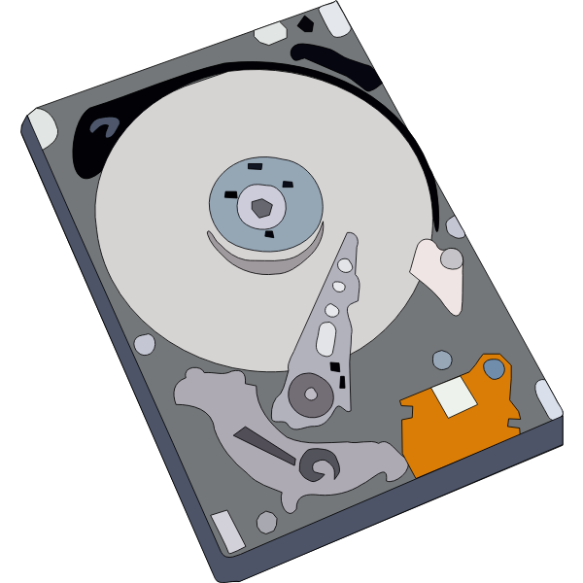

Storage at CURC
PetaLibrary
Local or Cloud
Core
Included with RC account
/home
/projects
scratch space
You can download your data locally or to a variety of other cloud resources
Cloud Foundations at Research Computing
Paid Service for:
Storage
Archive
Sharing of research data
Notes:
CU Research Computing hosts a free-to-use on-premise cloud service, called CUmulus, which supports cases not well-suited for HPC such as webservers, databases, and long-running services. The CUmulus service includes access to a Virtual Private Cloud (VPC) which provides users with a logically isolated section of the cloud with a small number of outside routable floating IP addresses. Within this VPC customers will be given an allocation of:
CPU cores
Memory
Storage

Slide 10
Data Sharing: Within RC
Sharing workspaces
Project space
Scratch Space
PetaLibrary Space*
*If you have purchased PetaLibrary space
Notes:
Highlight not sharing home space
Where configs are at, people can mess with them

Slide 11
Data Sharing: Outside RC
Globus (recommended):
GUI Web Application
Automates large transfers
Resumes failed transfers
Distributes large transfers across DTNs
Endpoints that can shared
Data Transfer Nodes (DTN)
Internal CU network needed (VPN)
Command line tools
scp, sftp, rsync, rclone

Slide 12

Cloud Computing
CURC supports both AWS and on-premise cloud via CUmulus
For use cases not well-supported by HPC
Can be used as an alternative to HPC
Can be used to enhance HPC
Automatic job submission, high availability, etc.
Request a CUmulus application by contacting the RC helpdesk at rc-help@colorado.edu
Notes:
Cloudbursting

Slide 13
Accessing Research Computing

Slide 14
How to Access RC Resources?
Get an RC account
Set up two-factor authentication with Duo
(Inform us of any specific needs)
Log in
Create greatness! (responsibly)

Slide 15
Getting an RC Account
University of Colorado, Boulder users and affiliates:
Request an account through the RC Account request portal
https://rcamp.rc.colorado.edu/accounts/account-request/create/organization
Colorado State University users:
Request an CSU eID if you don’t have one
Fill out account application form
Duo authentication
https://it.colostate.edu/duo-two-factor-authentication/how-to-register-devices/#register-app
CU Anschutz Users:
Create an ACCESS-CI Account in the ACCESS user portal
Reach out to hpcsupport@cuanschutz.edu to receive and sign the End-User Agreement
RMACC Users:
Create an ACCESS-CI Account in the ACCESS user portal
Email us at rc-help@colorado.edu and request an account. Please include the following information: your ACCESS username, your institutional affiliation, your role, your department, your first and last name, your preferred email address for communication

Slide 16
Demo: Getting an Account
CU Boulder, CSU users and affiliates:
Request an account through the RC Account request portal:
https://rcamp.rc.colorado.edu/accounts/account-request/create/organization
AMC, RMACC users and affiliates:
Request an account through the ACCESS-CI User Registration Portal:
https://identity.access-ci.org/new-user.html

Slide 17
Your RC Account
Access to:
Alpine Cluster
Core Storage
PetaLibrary Storage*
Open OnDemand
Approximately 2,000 Service Units (SUs) per month
*If purchased
Notes:
https://ondemand.rc.colorado.edu/
https://ondemand-rmacc.rc.colorado.edu/

Slide 18
Two Factor Authentication (Duo)
Provides an extra level of authentication
We are outside the firewall!
Valuable resources
Inviting, high-profile target
Duo
You will receive a Duo invitation when your RC account is created

Slide 19
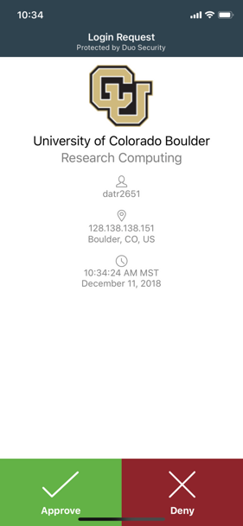
Duo Authentication
Duo smartphone app (recommended)
Phone Call/Text as alternatives

Slide 20
Demo: Logging in via Terminal
To login to an RC login node:
$ ssh <username>@login.rc.colorado.edu
Supply your IdentiKey password and your Duo app will alert you to confirm the login
*CU and CSU exclusive (AMC available by request)

Slide 21
Demo: logging in with OnDemand
CURC Open OnDemand is a browser based, integrated, single access point for all of your HPC resources at CU Research Computing.
CU Boulder: Visit https://ondemand.rc.colorado.edu.
Other RMACC Institutions: Visit https://ondemand-rmacc.rc.colorado.edu/

Slide 22
Logging In
It’s important to note that you are NOT logging into any specific resource, Alpine, Blanca, etc.
When you log in, you land on our login nodes
From there, you can access our other resources:
Alpine
Blanca
Petalibrary

Slide 23
Questions?
Documentation: curc.readthedocs.io/
Trainings with Center for Research Data and Digital Scholarship (CRDDS): https://www.colorado.edu/crdds/
Coming up:
RC Primer: Alpine New User Seminar (1/25)
RC Short Course: Supercomputing Spinup Part 1 – Working with Linux (1/30)
RC Short Course: Supercomputing Spinup Part 1 – Working with Linux (2/1)
Helpdesk: rc-help@colorado.edu
Consult Hours (Tuesday 12:00-1:00, Thursday 1:00-2:00)

Slide 24
Survey and feedback
http://tinyurl.com/curc-survey18

